Slide 1



CP302
CAPSTONE PROJECT 1
Under the guidance of
Dr. Sachin Kumar Associate Professor Department of Mechanical Engineering IIT Ropar
Submitted by
Group No. 03 Mohit Sharma (2022MEB1326) Priyanshu Gupta (2022MEB1330)

Slide 2

Title of project –
Machine Learning Based Fracture Characterization Using Phase Field Model

Slide 3
1. Introduction
Quasi-brittle materials (like concrete, ceramics, and rocks) soften gradually before fracturing, a key characteristic for predicting material failure in structures.
Challenges with Traditional Methods:
FEM and Phase-Field Models: Accurate but computationally expensive and require fine-tuning for complex fractures.
Phase-Field Model:
Represents fractures using a continuous damage parameter.
Computationally intensive, especially for large-scale problems.
Machine Learning Approach:
Physics-Informed ML integrates fracture mechanics equations for faster, more efficient simulations.
Focus Areas:
Predicting displacement.
Using a physics-based loss function to minimize errors.
Capturing softening behavior from intact material to full fracture.
Impact:
Efficient and scalable simulations.
Applications in civil engineering, aerospace, and materials science for safer, more reliable structures.

Slide 4
2. Objective
Developing a computational framework that predicts displacement and damage evolution in a structure under applied loading.
Formulating a physics-informed loss function, which are Residuals of phase field equation.
Extending the approach to capture fracture propagation and material softening behaviour

Slide 5
3. Background and Theory
3.1. Historical Context and Motivation for Fracture Modelling
Fracture mechanics has evolved over centuries, beginning with early observations by Leonardo da Vinci and Galileo Galilei, who noted that material strength depends on size and shape, and introduced scaling laws for materials under tension and bending. In the 19th century, the use of iron and steel raised concerns about fracture-related failures, with David Kirkaldy conducting large-scale experiments on these materials, providing early insights into their brittleness. The field progressed significantly in 1920 when Alan Griffith introduced an energy-based theory explaining that cracks propagate when the energy released by an advancing crack exceeds a critical threshold. This theory, forming the basis of Linear Elastic Fracture Mechanics (LEFM), became crucial during and after World War II, especially following failures in Liberty ships and Comet aircraft, which highlighted the need for a deeper understanding of fracture mechanics in engineering design.

Slide 6
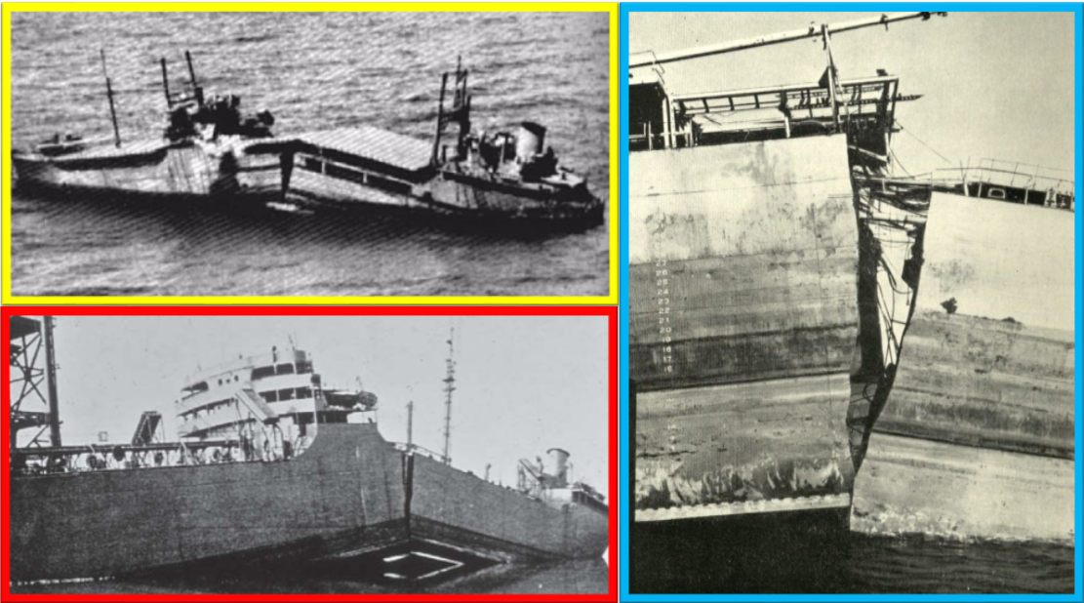
Fig. Brittle fracture caused in Liberty Ship, yellow box- top view, red box- side view, blue box- fracture at centered
While LEFM was effective for brittle materials, it could not explain the fracture behavior of ductile and quasi-brittle materials, which exhibit softening behavior before failure. This limitation led to the development of Elasto-Plastic Fracture Mechanics (EPFM) and Cohesive Zone Models (CZM), which account for plastic deformation and damage evolution. In the late 20th century, computational methods such as Finite Element Methods (FEM) and Phase Field Models (PFM) emerged, with the Phase Field Method gaining popularity for representing fractures as a continuous field, thus eliminating the need for explicit crack tracking. However, these methods are computationally expensive, particularly for simulating complex crack propagation in large-scale problems.

Slide 7
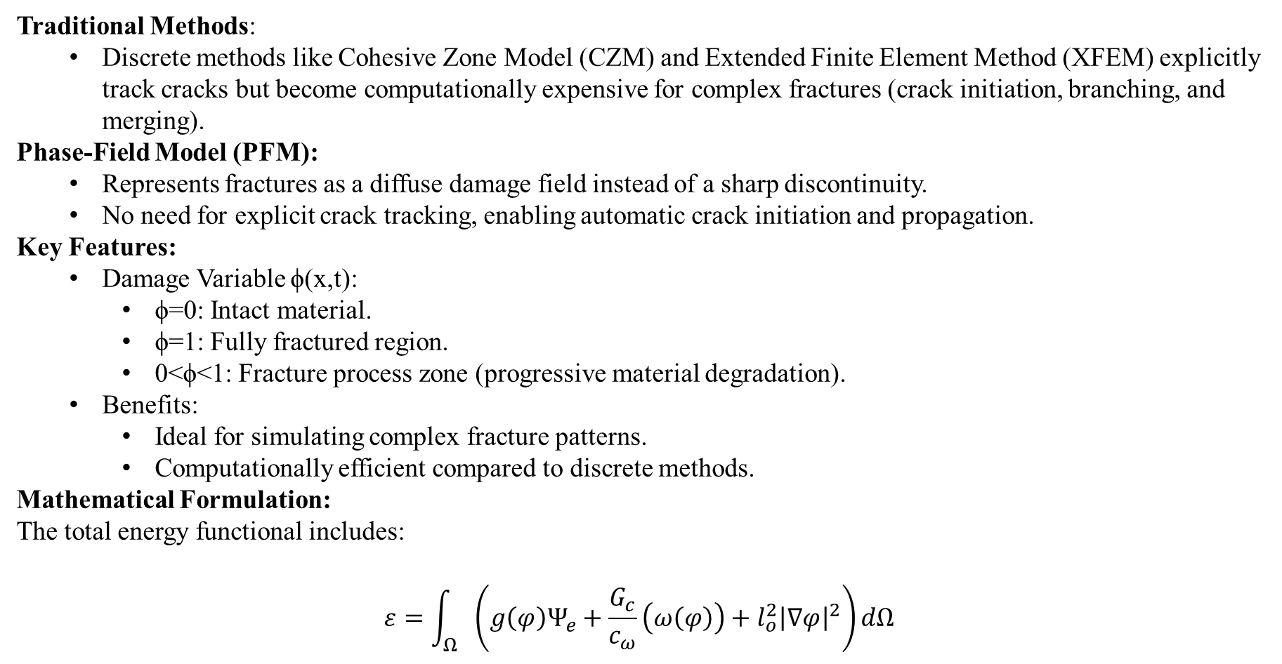
3.2. Phase-Field Model for Fracture Prediction
Traditional Methods:
Discrete methods like Cohesive Zone Model (CZM) and Extended Finite Element Method (XFEM) explicitly track cracks but become computationally expensive for complex fractures (crack initiation, branching, and merging).
Phase-Field Model (PFM):
Represents fractures as a diffuse damage field instead of a sharp discontinuity.
No need for explicit crack tracking, enabling automatic crack initiation and propagation.
Key Features:
Damage Variable ϕ(x,t):
ϕ=0: Intact material.
ϕ=1: Fully fractured region.
0<ϕ<1: Fracture process zone (progressive material degradation).
Benefits:
Ideal for simulating complex fracture patterns.
Computationally efficient compared to discrete methods.
Mathematical Formulation:
The total energy functional includes:
$$ε=\int_{Ω}{\left(g\left(φ\right)Ψ_{e}+\frac{G_{c}}{c_{ω}}\left(ω\left(φ\right)\right)+l_{o}^{2}{\left|∇φ\right|}^{2}\right)}dΩ$$

Slide 8
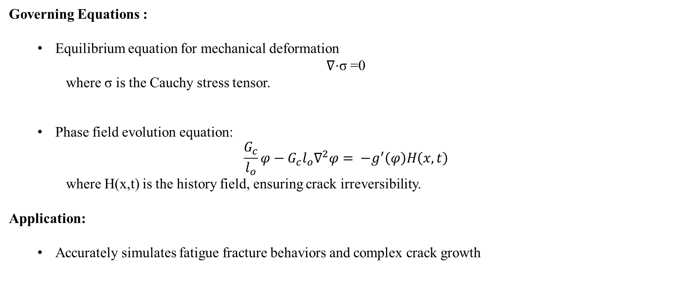
Governing Equations :
Equilibrium equation for mechanical deformation
∇⋅σ =0
where σ is the Cauchy stress tensor.
Phase field evolution equation:
$$\frac{G_{c}}{l_{o}}φ−G_{c}l_{o}∇^{2}φ= −g^{′}\left(φ\right)H\left(x,t\right)$$
where H(x,t) is the history field, ensuring crack irreversibility.
Application:
Accurately simulates fatigue fracture behaviors and complex crack growth

Slide 9
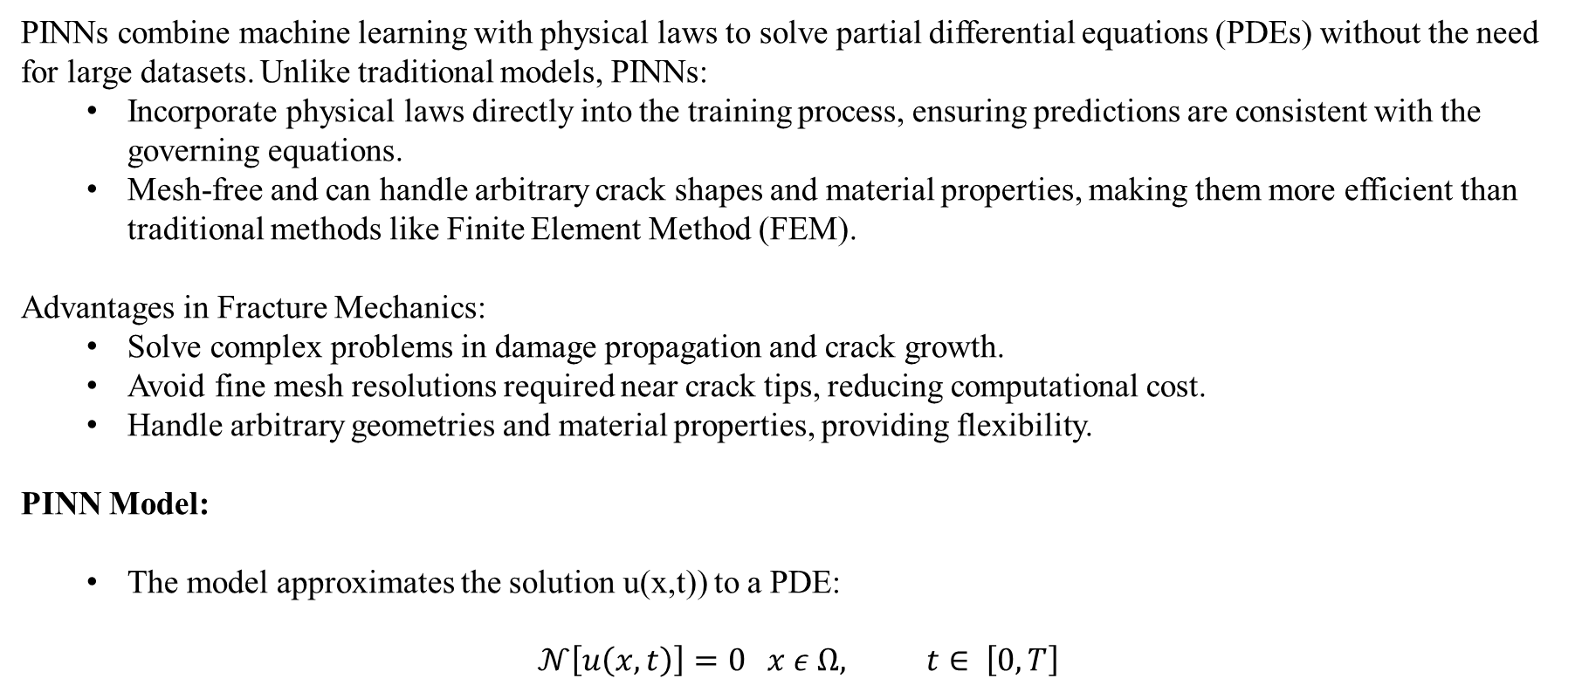
3.3. Physics-Informed Neural Networks (PINNs) for Fracture Mechanics
PINNs combine machine learning with physical laws to solve partial differential equations (PDEs) without the need for large datasets. Unlike traditional models, PINNs:
Incorporate physical laws directly into the training process, ensuring predictions are consistent with the governing equations.
Mesh-free and can handle arbitrary crack shapes and material properties, making them more efficient than traditional methods like Finite Element Method (FEM).
Advantages in Fracture Mechanics:
Solve complex problems in damage propagation and crack growth.
Avoid fine mesh resolutions required near crack tips, reducing computational cost.
Handle arbitrary geometries and material properties, providing flexibility.
PINN Model:
The model approximates the solution u(x,t)) to a PDE:
$$𝒩\left[u\left(x,t\right)\right]=0 x ε Ω, t∈ \left[0,T\right]$$

Slide 10
It predicts:
Displacement fields u(x,t).
Phase-field variable ϕ(x,y) which models crack evolution.
Loss Function:
The model is trained using a combined loss function:
Residual loss ensures solutions satisfy the governing PDEs.
Boundary loss enforces boundary conditions.
Energy loss maintains consistency with the phase-field energy functional.
Impact:
More accurate and efficient than traditional methods.
Faster predictions after training, making it ideal for real-time simulations and large-scale geometries.

Slide 11
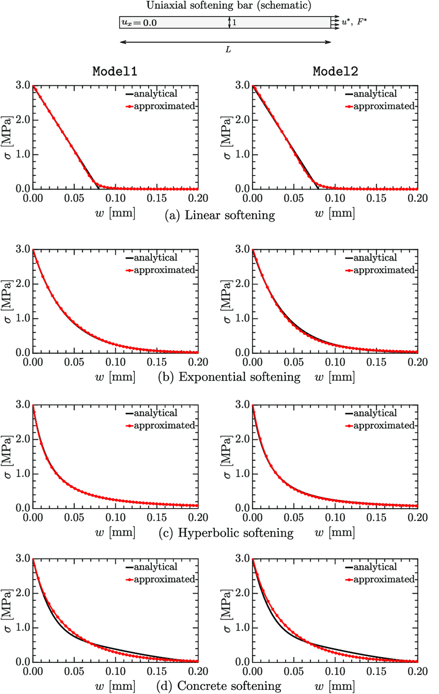
3.4. Softening Paraments in Fracture Mechanics
In fracture mechanics, materials like concrete, ceramics, and some metals experience gradual softening before complete failure. As cracks propagate, the material undergoes a progressive loss of stiffness and load-bearing capacity, which is crucial for predicting material degradation and structural failure.
Fig. General softening curves[8]

Slide 12
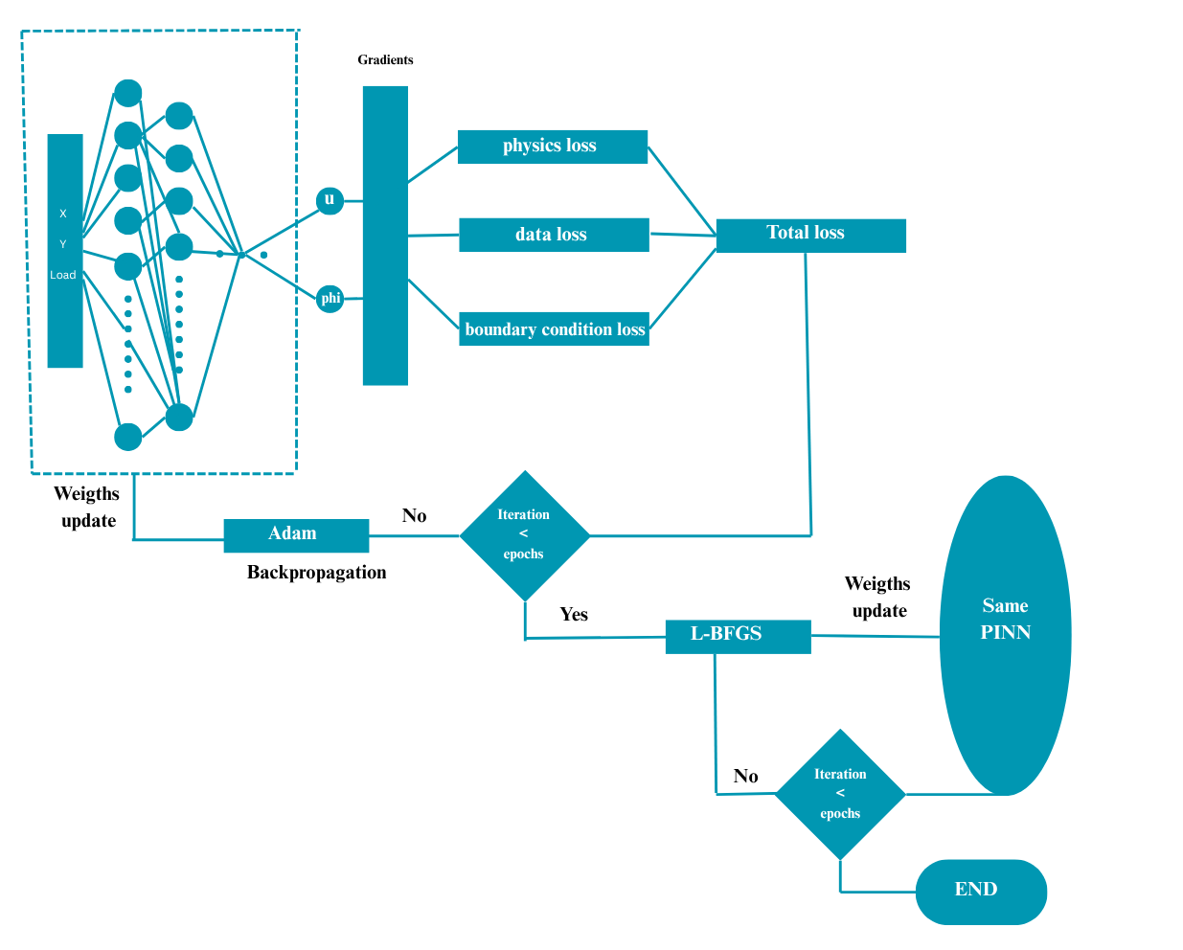
4.Methodology
4.1. Modelling Approach
In this project, the primary objective is to predict displacement and damage evolution in materials under applied loads, using a Physics-Informed Neural Network (PINN). The Modelling Approach combines traditional fracture mechanics principles with the flexibility of machine learning to predict crack initiation, growth, and the resulting material degradation. PINNs are employed to incorporate physical laws directly into the learning process, ensuring that the predictions are both accurate and physically consistent.
Fig. Schematic Diagram of PINN

Slide 13
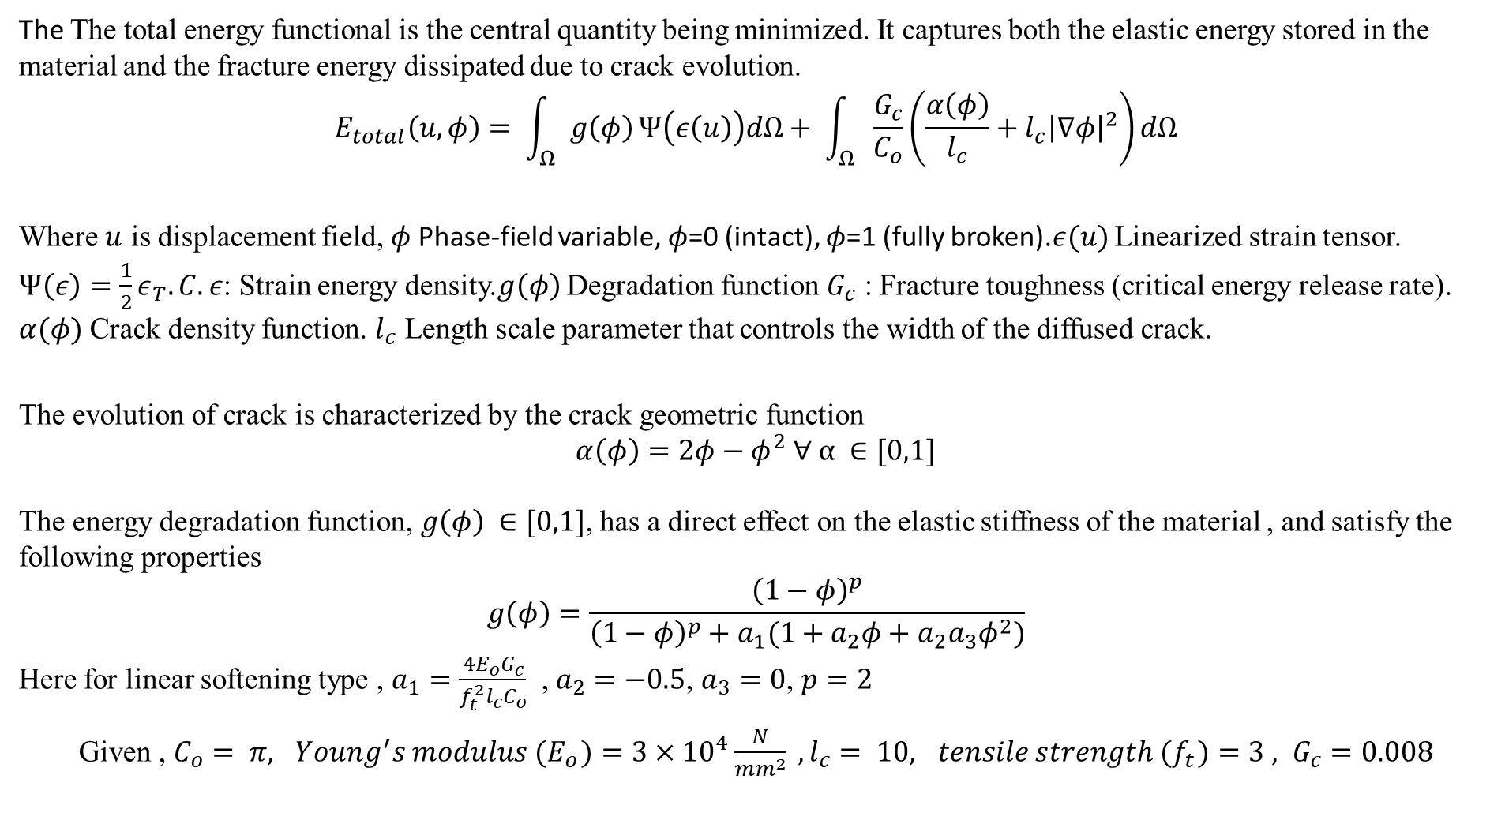
The The total energy functional is the central quantity being minimized. It captures both the elastic energy stored in the material and the fracture energy dissipated due to crack evolution.
$$E_{total}\left(u,φ\right)= \int_{Ω}{g\left(φ\right)}Ψ\left(ε\left(u\right)\right)dΩ+ \int_{Ω}{\frac{G_{c}}{C_{o}}\left(\frac{α\left(φ\right)}{l_{c}}+l_{c}{\left|∇φ\right|}^{2}\right)dΩ}$$
Where $u$ is displacement field, $φ$ Phase-field variable, $φ$=0 (intact), $φ$=1 (fully broken).$ε(u)$ Linearized strain tensor. $Ψ\left(ε\right)=\frac{1}{2}ε_{T}.C.ε$: Strain energy density.$g\left(φ\right)$ Degradation function $G_{c}$ : Fracture toughness (critical energy release rate). $α(φ)$ Crack density function. $l_{c}$ Length scale parameter that controls the width of the diffused crack.
The evolution of crack is characterized by the crack geometric function
$$α\left(φ\right)=2φ−φ^{2} ∀ α ∈[0,1]$$
The energy degradation function, $g\left(φ\right) ∈[0,1]$, has a direct effect on the elastic stiffness of the material , and satisfy the following properties
$$g\left(φ\right)=\frac{{\left(1−φ\right)}^{p}}{{\left(1−φ\right)}^{p}+a_{1}(1+a_{2}φ+a_{2}a_{3}φ^{2})}$$
Here for linear softening type , $a_{1}=\frac{4E_{o}G_{c}}{f_{t}^{2}l_{c}C_{o}}$ , $a_{2}=−0.5$, $a_{3}=0$, $p=2$
Given , $C_{o}= π, { Young^{′}s modulus (E}_{o})=3×{10}^{4}\frac{N}{mm^{2}} ,l_{c}= 10, { tensile strength (f}_{t})=3 , G_{c}=0.008$

Slide 14
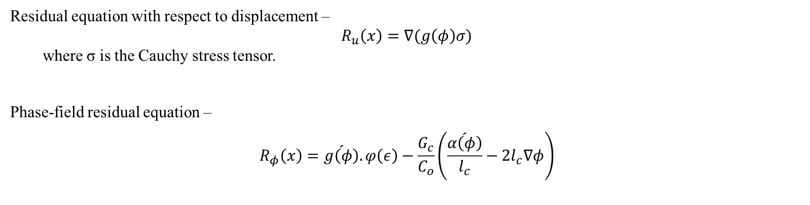
Residual equation with respect to displacement –
$$R_{u}\left(x\right)=∇(g\left(φ\right)σ)$$
where σ is the Cauchy stress tensor.
Phase-field residual equation –
$$R_{φ}\left(x\right)=\acute{g\left(φ\right)}.φ\left(ε\right)−\frac{G_{c}}{C_{o}}\left(\frac{\acute{α\left(φ\right)}}{l_{c}}−2l_{c}∇φ\right)$$
4.1.2 PINNS
PINNs integrate machine learning with physical laws to solve partial differential equations (PDEs), especially for complex problems like fracture mechanics. By incorporating governing physical equations directly into the loss function, PINNs ensure that predictions align with the physical behavior of the system.
Key Features:
Residual Loss: Ensures the solution satisfies governing PDEs for displacement and damage evolution.
Boundary Loss: Enforces boundary conditions (e.g., displacement, force).
Energy Loss: Ensures consistency with energy principles governing material behavior.

Slide 15
Advantages:
Mesh-free: Eliminates the need for explicit meshing.
Computational Efficiency: More efficient than FEM and FDM, especially for complex geometries and crack paths.
Versatility: Handles intricate crack propagation and material heterogeneity.
By minimizing the combined loss function, the model predicts displacement and damage evolution while adhering to fracture mechanics principles.
4.2. Data Collection and Preprocessing
The dataset was obtained from an FEM-based numerical simulation of an axial bar under load. The input features included the applied force at the last node, X and Y coordinates of the nodes. The target variables were the displacements and damage on the input nodes.
Preprocessing Steps:
Feature Scaling:
Applied MinMaxScaler to X and Y coordinates, load, Displacement to scale values between [0, 1].
Prevented model bias towards larger features, ensuring equal importance across all features.

Slide 16
Train-Test Split:
80-20 split: 80% for training, 20% for validation.
Ensured the model generalizes well and doesn't overfit to the training data.
Shuffling and Batching:
Shuffling to randomize data and prevent model overfitting.
Batch size of 128.
Tensor Conversion:
Converted data into TensorFlow tensors for seamless training with TensorFlow’s architecture.
4.3. Neural Network Architecture
The Neural Network (NN) was designed to model the complex relationship between applied load and resulting displacements at various nodes.

Slide 17
Model Structure:
Input Layer: Receives the applied load at the last node, and the X and Y coordinates of the point where displacement and damage are predicted.
Hidden Layers: Six fully connected layers with tanh activation functions, with decreasing numbers of neurons (2048, 1024, 512, 256, 128, and 64).
Output Layer: Two neurons, one for displacement prediction and one for damage prediction.
2. Model Training:
Optimizer: Initially trained with Adam (learning rate = 0.0001), followed by L-BFGS for fine-tuning the model weights.
3. Loss:
Total Loss = Physics-Loss + Data-Loss + B.C-Loss
4. Model Evaluation:
Metrics: Evaluates using R² score and Mean Squared Error (MSE) to measure prediction accuracy during training.
5. Training Process:
Batch Gradient Descent with backpropagation and Physics-Informed Loss over 50 epochs, followed by weight refinement using L-BFGS.

Slide 18

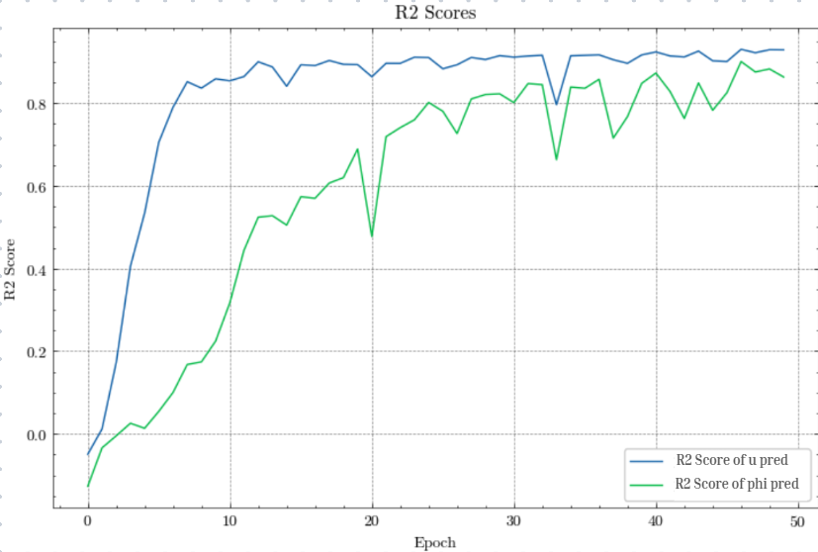
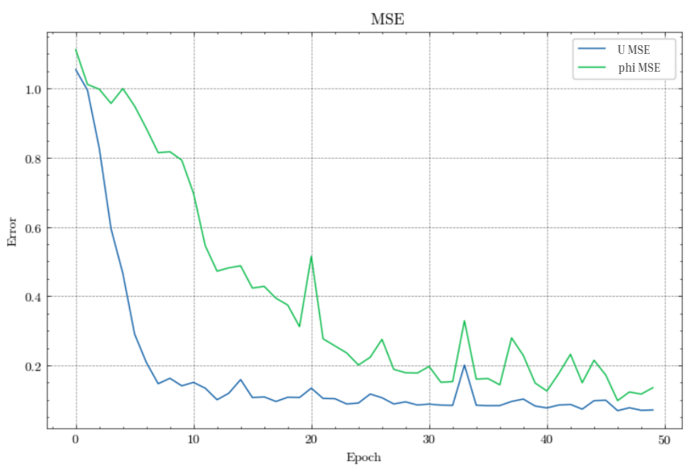
5.Results
The model was trained for 50 epochs with a batch size of 128. The performance was assessed using
Loss and Validation Loss: The loss function values were monitored over training epochs to evaluate convergence.
R2- Score: Used to assess prediction accuracy.

Slide 19
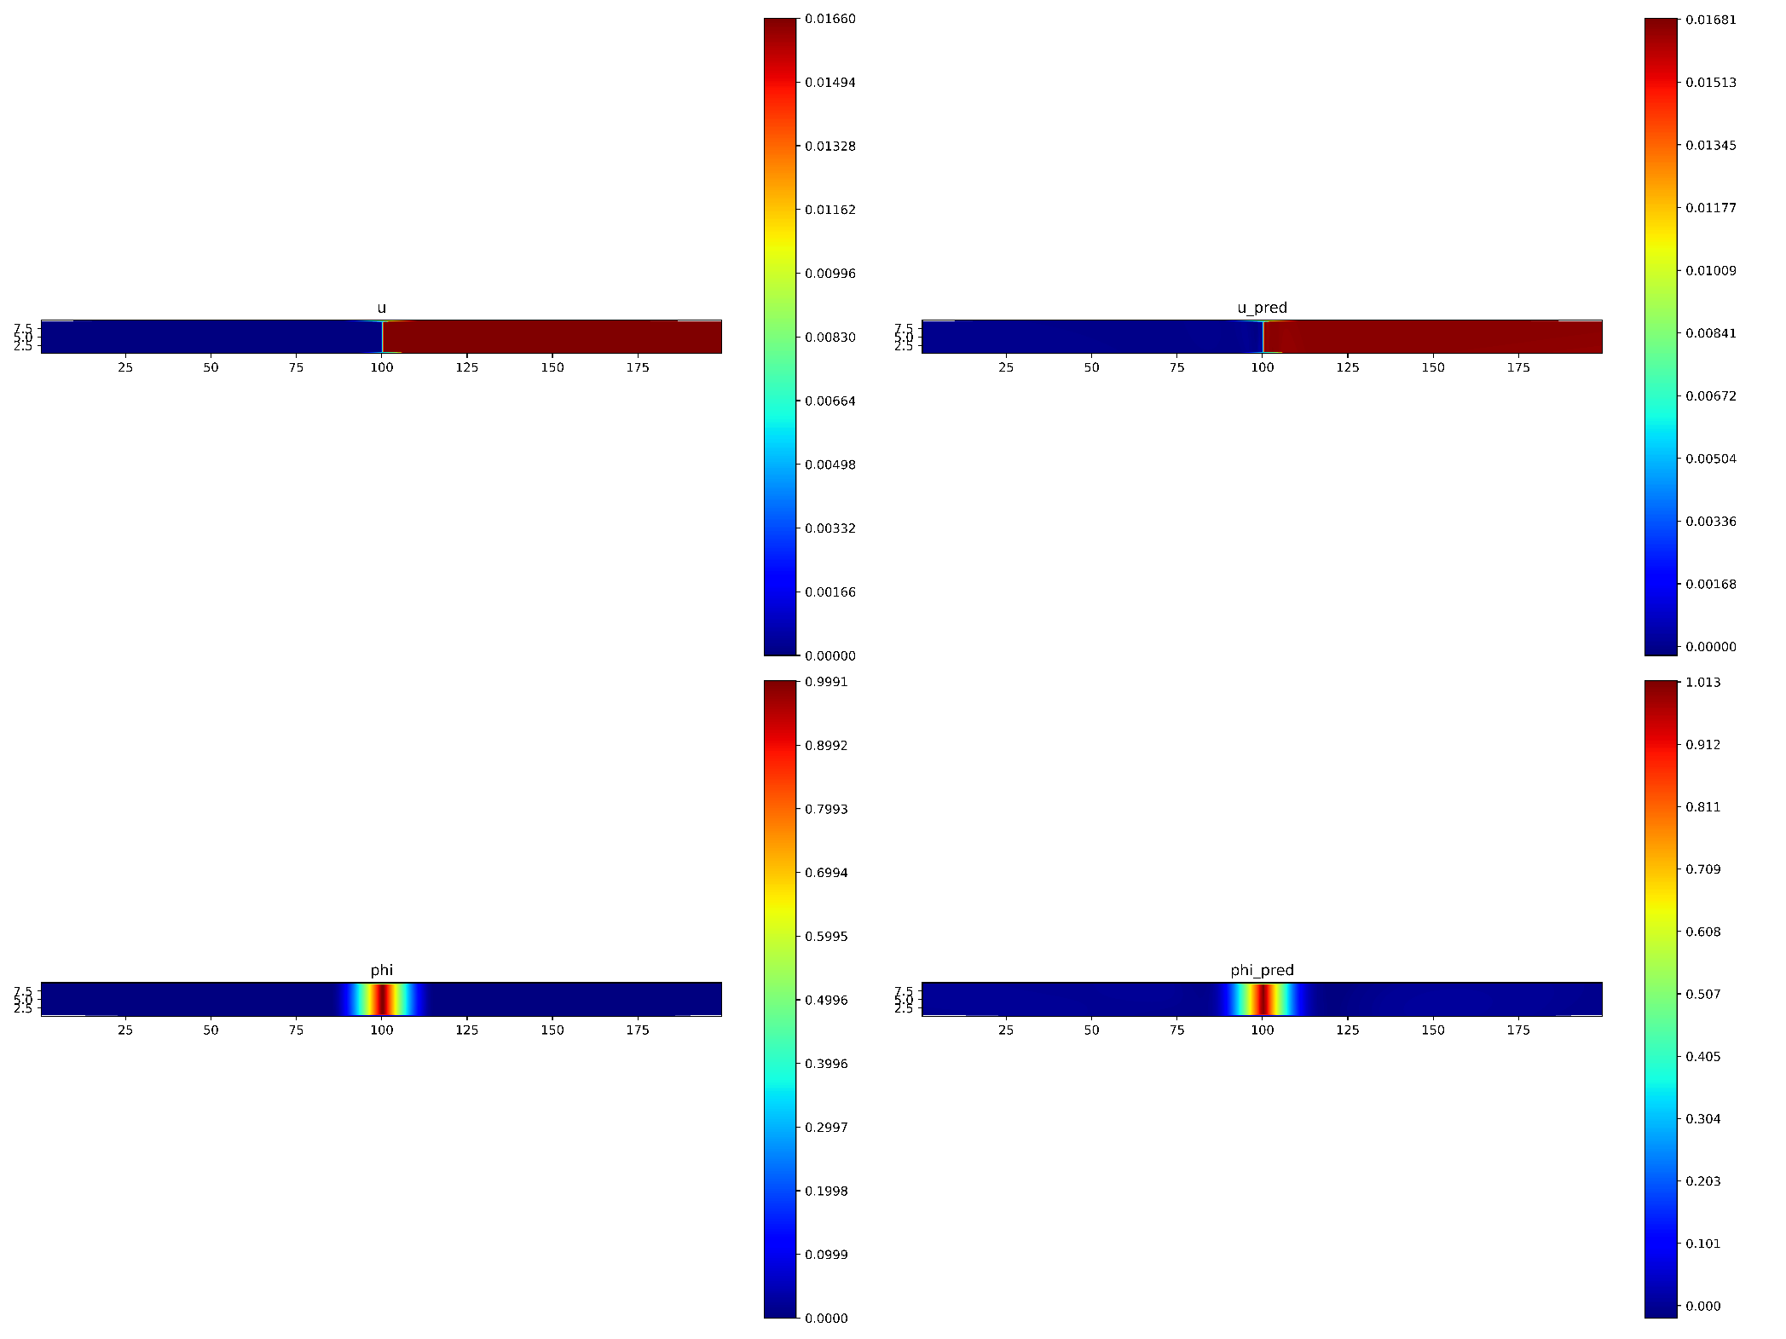
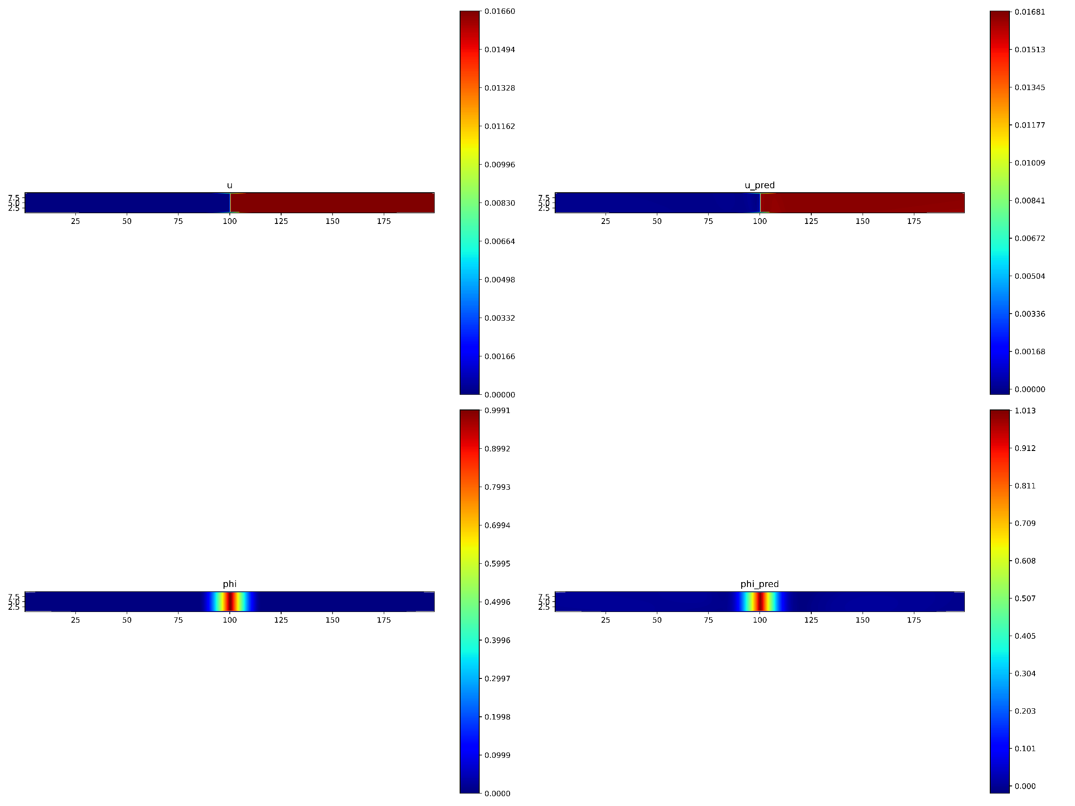
Prediction of displacement (u)
Actual displacement (u) along the bar
Predicted displacement distribution ($u_pred$ ) along the bar

Slide 20
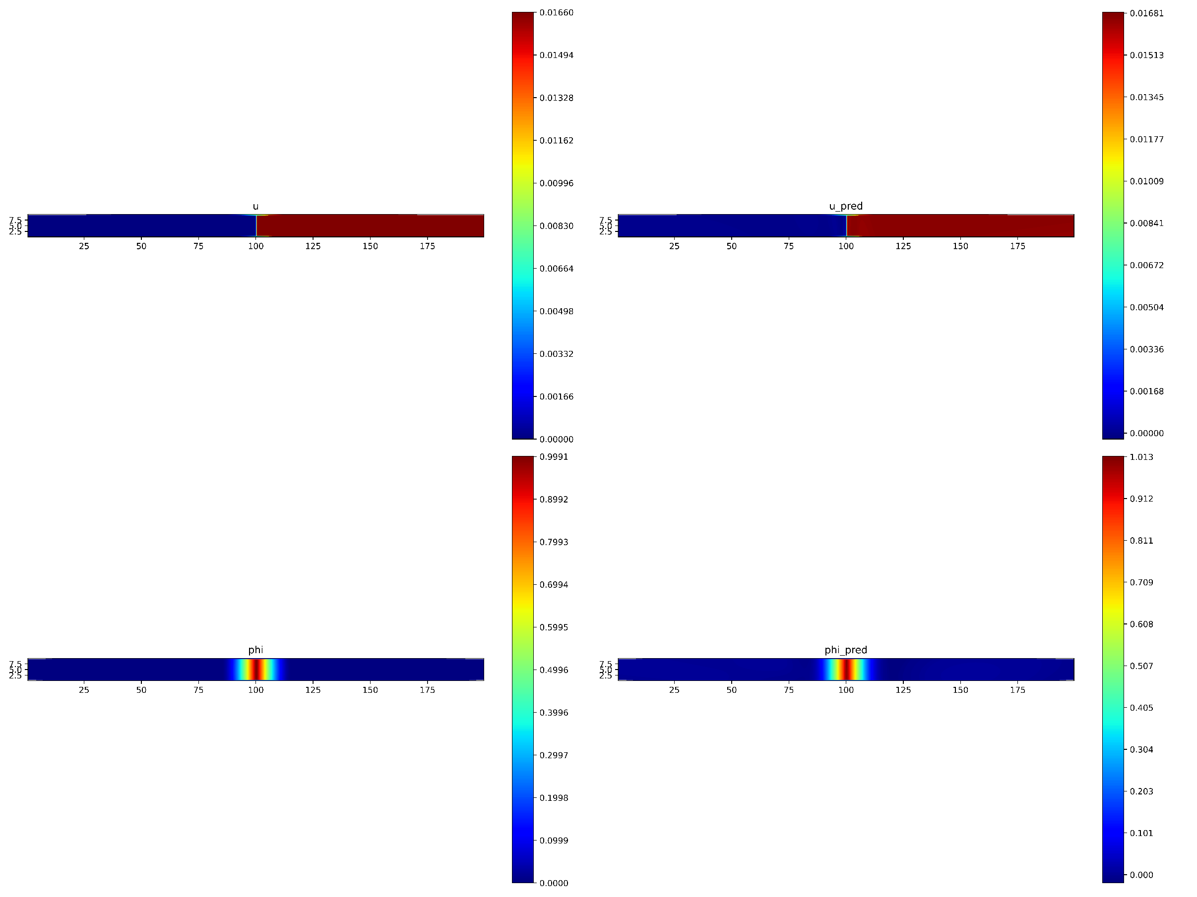

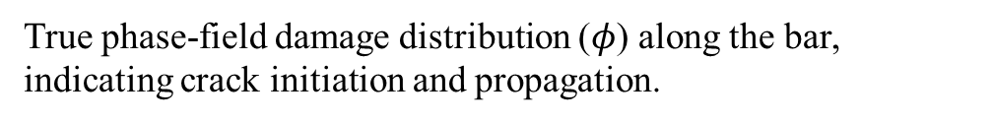
Prediction of phase-field damage distribution $(φ)$
True phase-field damage distribution ($φ$) along the bar, indicating crack initiation and propagation.
Predicted phase-field damage distribution ($φ$ ) along the bar

Slide 21
6. Conclusion & Discussion
This project successfully developed a Physics-Informed Neural Network (PINN) model to predict displacement and damage evolution in a material under axial loading. The model effectively captured the relationship between applied load, displacement, and crack propagation, using physics-informed loss functions to ensure physical consistency. The predictions for displacement and phase-field damage closely matched the true values from the simulation, offering a promising alternative to traditional methods like FEM for fracture mechanics problems.

Slide 22
7. Future Work
Future work will focus on predicting the softening behavior of quasi-brittle materials, which is essential for modelling material failure as cracks propagate. The next steps include:
Calculating the internal forces in order to create a material response curve.
Reverse engineer the general softening curves for various profiles in order to predict softening response.
Validating the enhanced model using experimental or simulation data to assess its accuracy in predicting softening under different loading conditions.
Expanding the model to include softening behavior will improve its ability to simulate material failure and enhance its applicability in engineering design and structural health monitoring.

Slide 23
8. References
[1] B. Cotterell, “The past, present, and future of fracture mechanics.” [Online]. Available: www.elsevier.com/locate/engfracmech
[2] S. Goswami, C. Anitescu, S. Chakraborty, and T. Rabczuk, “Transfer learning enhanced physics informed neural network for phase-field modeling of fracture,” Theoretical and Applied Fracture Mechanics, vol. 106, Apr. 2020, doi: 10.1016/j.tafmec.2019.102447.
[3] H. Cui, C. Du, and H. Zhang, “Applications of Phase Field Methods in Modeling Fatigue Fracture and Performance Improvement Strategies: A Review,” Apr. 01, 2023, MDPI. doi: 10.3390/met13040714.
[4] A. Fallah and M. M. Aghdam, “Physics-informed neural network for bending and free vibration analysis of three-dimensional functionally graded porous beam resting on elastic foundation,” Eng Comput, vol. 40, no. 1, pp. 437–454, Feb. 2024, doi: 10.1007/s00366-023-01799-7.
[5] J. Y. Wu, “A unified phase-field theory for the mechanics of damage and quasi-brittle failure,” J Mech Phys Solids, vol. 103, pp. 72–99, Jun. 2017, doi: 10.1016/j.jmps.2017.03.015.
[6] E. Lorentz and V. Godard, “Gradient damage models: Toward full-scale computations,” Comput Methods Appl Mech Eng, vol. 200, no. 21–22, pp. 1927–1944, May 2011, doi: 10.1016/j.cma.2010.06.025.
[7]A. Pandey and S. Kumar, “A multi-level adaptive mesh refinement strategy for unified phase field fracture modeling using unstructured conformal simplices,” Comput Methods Appl Mech Eng, vol. 433, Jan. 2025, doi: 10.1016/j.cma.2024.117514.
[8] https://www.researchgate.net/figure/General-softening-curves-using-using-proposed-models-f-t-D-30-MPa-G-f-D-012-N-mm_fig4_356816231

Slide 24


